Slide 1
Human Rights Advocacy in Mental Health
Artin A. Mahdanian, MD FRCPC
Consultant Psychiatrist

Slide 2
Disclosures
No financial conflict of interest
Not representing any organization

Slide 3
My Journey
MD Tehran University (IMG)
GP: 1-Baluchistan, 2- Armenian Clinic, 3- Train physician
MSc and Psychiatry Residency at McGill University
Internship: World Health Organization, Geneva, Switzerland
Internship: Center for Global Mental Health, LSHTM, London, UK
CL Psychiatry fellowship at Johns Hopkins University
Telehealth Consultant in QC, DC, MD

Slide 4
Definition of human rights
Basic rights and freedoms to which all individuals are entitled, regardless of their nationality, ethnicity, gender, religion, or any other status
Essential for human dignity, equality, and the development of individuals and societies
Inherent

Slide 5
Human rights categories
Civil and political rights
right to life, liberty, and security of person, freedom of speech, freedom of religion, the right to a fair trial, etc.
Economic, social, and cultural rights
right to education, adequate housing, healthcare, and the right to participate in cultural and scientific activities

Slide 6
Universal Declaration of Human Rights United Nations1948 (30 articles)
Free and equal
Life, liberty, and security
No degrading, inhumane treatment
No arbitrary detention
Privacy
Freedom of movement
Express opinion
Work and employment
Food and Shelter
Education
Fair and free world
Right to Health and Health Care
?Dignity in Death?

Slide 7
Convention on The Rights of Persons with Disabilities (CRPD)
50 articles, of which 5–30 define the rights of persons with disabilities and the obligations of states
Rights to: accessibility, live independently, autonomy, inclusion in the community, personal mobility, habilitation and rehabilitation, and participation
Reform of mental health acts that allow any form of coercion

Slide 9
5 Key Human Rights in Mental Health Care
Right to access treatment
Everyone should have equal access to mental health care services
Barriers to access should be minimized or eliminated
Right to informed consent
Individuals have the right to be fully informed about their treatment options.
Informed consent should be obtained before any treatment is administered.

Slide 10
Right to dignity and non-discrimination
Every person with a mental health condition deserves to be treated with dignity and respect.
Discrimination based on mental health status should be eliminated.
Right to least restrictive environment
Treatment and care should be provided in the least restrictive setting possible.
Avoid (unnecessary) use of coercion, seclusion, restraint, or substitute decision making
Right to privacy and confidentiality
Confidentiality of mental health information should be respected and protected.
Information sharing should follow ethical guidelines and legal frameworks.

Slide 11
Common Human Rights Violations in MH Settings

Slide 12
Lack of access & resources
Some countries may lack adequate services; others may limit access to certain population segments
32% of countries have no community care facilities
30% of countries have no specified budget for mental health; of those that do, 20% spend less than 1% of health budget on MH
Number of psychiatrists ranges from 10 per 100,000 to 1 per 300,000
WHO recommendation: mental health care should be available at the community level for everyone who needs it

Slide 13
Stigma, discrimination, and violation of basic rights
Deprived of civil rights (marriage, employment, education, right to shelter)
People restrained with metal shackles, caged beds, other inhumane treatment
People living in filthy conditions, lacking clothes, food, heating, proper bedding, or hygiene facilities
People isolated from society in large institutions, far from family and loved ones
Who recommendation: people with mental health conditions have the same human rights as everyone else; due to vulnerability, countries have a responsibility to protect them from discrimination

Slide 14
Inappropriate detention in prison:
In some countries people with mental disorders are in prison due to a lack of mental health services or lack of a diagnosis/treatment for their condition; “prisoners” continue to go unnoticed, undiagnosed, untreated
WHO recommendation: people with mental health conditions should be diverted away from criminal justice systems and toward mental health services

Slide 15
Inappropriate forced admission or treatment
Informed consent
People are forced against their will in mental health facilities
WHO recommendation: informed consent must form the basis of all mental health care; rigorous and ongoing procedural safeguards need to be in place to protect against abuse of involuntary admission and treatment

Slide 16
Political Abuse of Psychiatry
Misuse or manipulation of psychiatric diagnosis, treatment, or confinement for any purposes other than for legitimate health reasons
Psychiatric institutions, professionals, or governments exploit psychiatry as a means to suppress dissent, silence opposition, or control individuals or groups deemed to be a threat to the political regime

Slide 17
Characteristics of Abuse
Psychiatric diagnosis as a tool of repression: authorities employ psychiatric diagnoses, often without proper clinical assessment, to label political dissidents, activists, or whistleblowers as mentally ill in order to discredit them or justify their detention
Forced hospitalization and treatment: dissidents may be forcibly hospitalized in psychiatric institutions and subjected to treatments such as medications, electroconvulsive therapy (ECT), or other interventions against their will, solely for political reasons rather than genuine therapeutic purposes
Coercive interrogation and punishment: psychiatric facilities may be used as sites for coercive interrogation or punishment, where individuals are subjected to psychological pressure, intimidation, or torture under the guise of mental health treatment
Suppression of free speech and expression: suppress free speech and expression by instilling fear among individuals and discouraging dissenting opinions through the threat of psychiatric intervention
Lack of independent oversight: the absence of independent oversight or accountability mechanisms within psychiatric institutions allows for unchecked power, enabling the political abuse of psychiatry to occur

Slide 18
Examples of Political Abuse of Psychiatry
United States:
Drapetomania: a pseudo-scientific diagnosis created by American physician Samuel A. Cartwright as a mental disorder that caused enslaved Black Americans to have an irrational desire to escape slavery.
During the 60s and 70s: counterintelligence program known as COINTELPRO targeted various activist groups, including civil rights activists and anti-war protestors, and there were reports of individuals being subjected to psychiatric evaluations and treatment as a means of harassment or discrediting their political activities
2. Canada:
Canadian government’s “MK-ULTRA” and "LSD experiments" conducted by the Central Intelligence Agency (CIA) and McGill University.

Slide 19
3. United Kingdom:
In the 1980s and 1990s, there were allegations of political abuse of psychiatry in the united kingdom related to the treatment of Irish Republican Army (IRA) suspects. Some individuals claimed that they were diagnosed with mental illnesses to undermine their credibility or to justify their detention without trial.
4. Soviet Union:
The soviet union's practice of "psychiatric repression" involved diagnosing political dissidents with mental disorders such as "sluggish schizophrenia" or "delusion of reformism" to discredit and institutionalize them
Prominent cases include the psychiatric confinement of Nobel laureate Andrei Sakharov and human rights activist Natalya Gorbanevskaya

Slide 20
Other Hx
East Germany: Stasi, case of singer-songwriter Wolf Biermann
Romania: dissident playwright and journalist Paul Goma
South Africa: “Psychiatric Torture Project" of Security Police targeted antiapartheid activists, including Steve Biko

Slide 21
Current Examples
China:
Using psychiatry to silence political dissidents and suppress religious or ethnic minorities
The "crime" of "political lunacy" has been used to detain individuals deemed as threats to the regime, such as human rights lawyer Wang Wanxing and democracy advocate Xu Wanping
2. Russia:
Notable cases include the detention and forced psychiatric evaluation of journalist Alexander Sitnikov and the forced psychiatric hospitalization of opposition activist Natalia Sharina

Slide 22
3. Belarus:
Aftermath of the disputed 2020 presidential election
The case of journalist and activist Raman Pratasevich.
4. Turkey:
Aftermath of the attempted coup in 2016. Critics claim that psychiatric diagnoses have been used to target and imprison government opponents
Notable cases include the detention and treatment of prominent journalist Ahmet Altan and the incarceration of civil society advocate Osman Kavala.

Slide 23
5. Iran:
Aftermath of Woman-Life-Freedom movement
Reports of using psychiatric diagnoses and treatments as a means to silence dissent and control political opponents.
Forced psychiatric hospitalizations, medication, and treatments against their will.
Detention of underage protestors as antisocial
Use of psychedelics for interrogations

Slide 24
Some Advocacy Examples

Slide 25
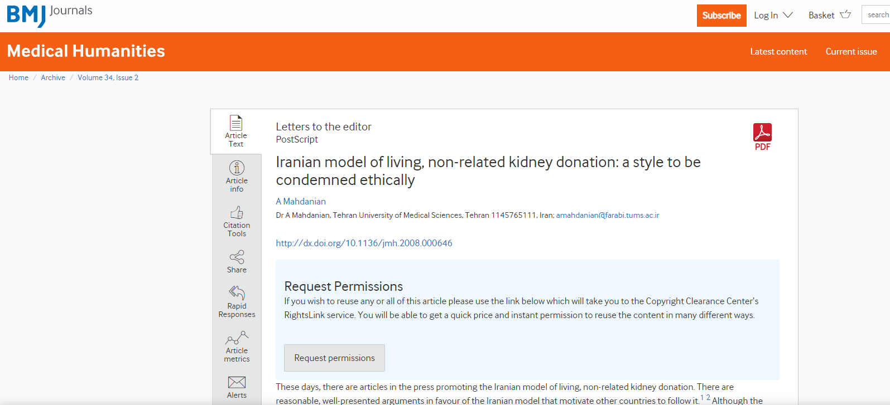

Slide 27
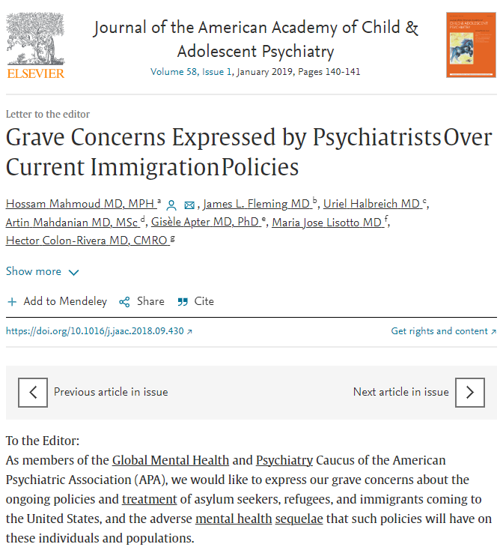

Slide 28
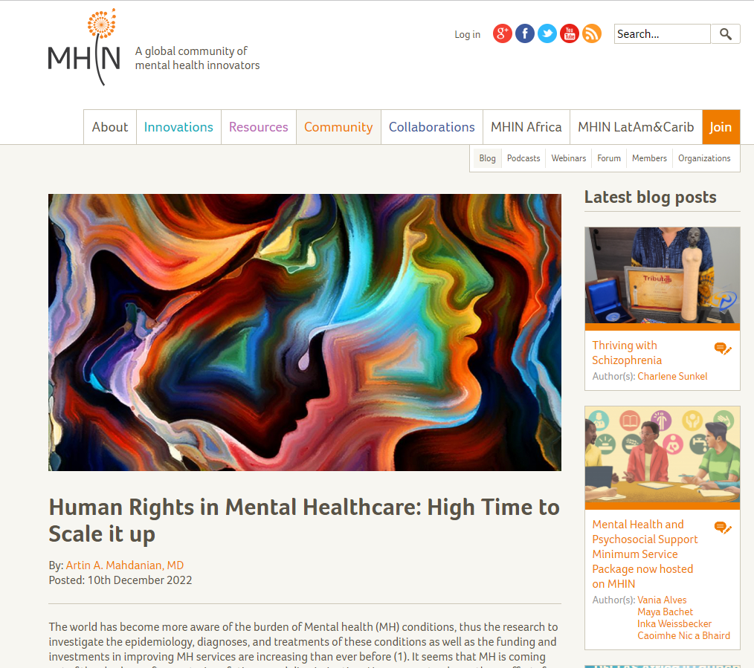

Slide 29
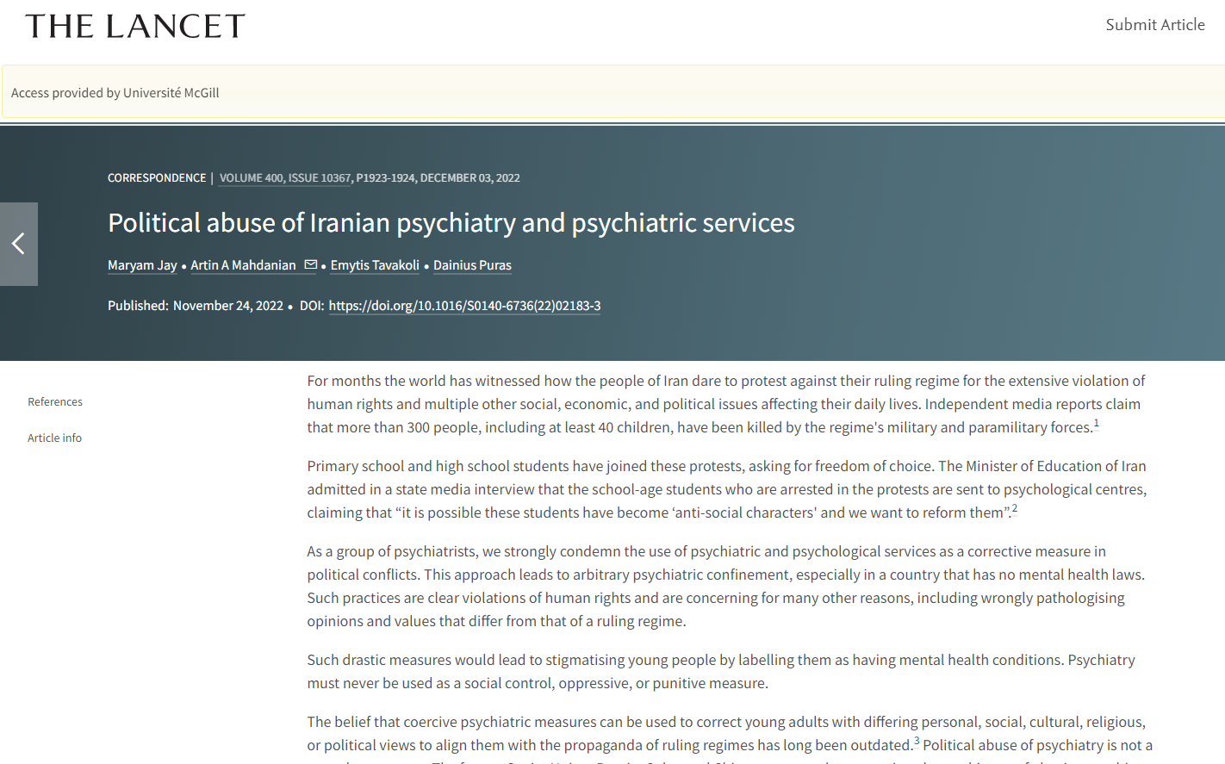

Slide 30
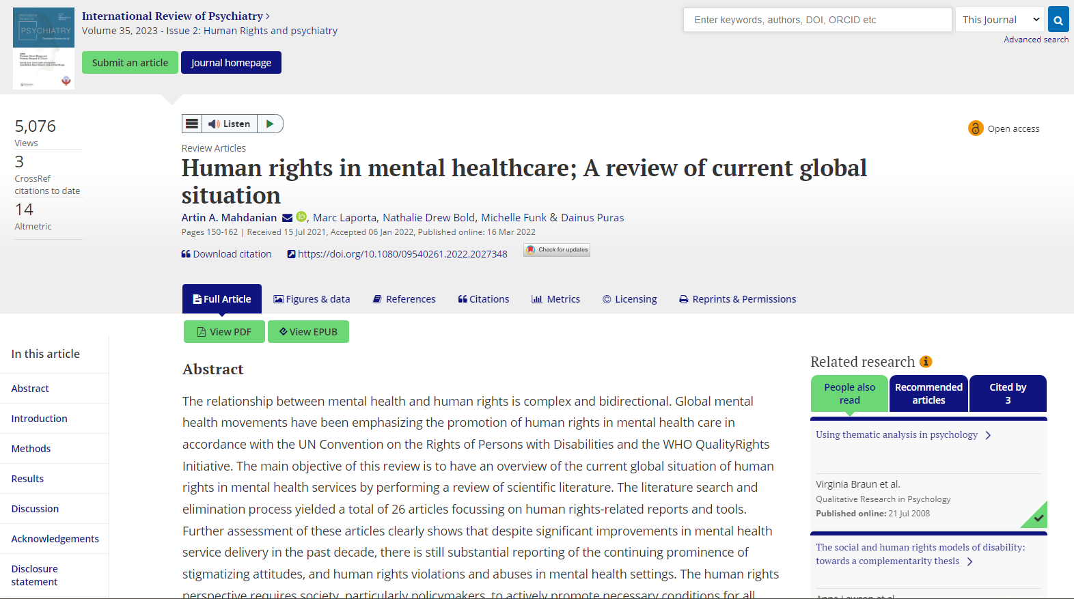

Slide 31
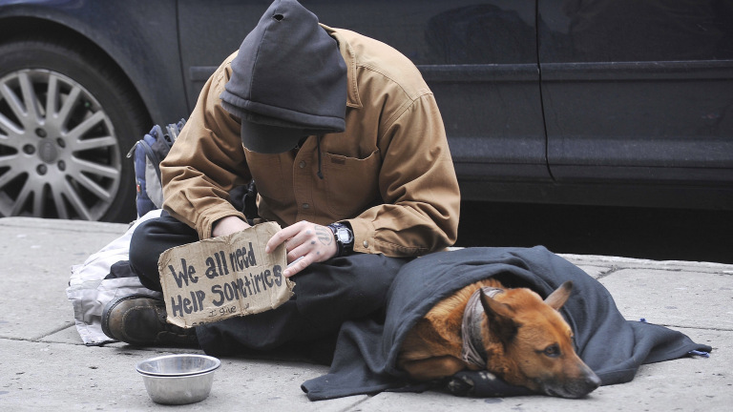
Think Global ADVOCATE Local

Slide 32
WWW.DrArtin.com

